Slide 1
Basic of atomic theories, Introduction to particle physics, Standard Model
Name: Asiya Shoaib
Roll No: 072-CY 25-F

Slide 2
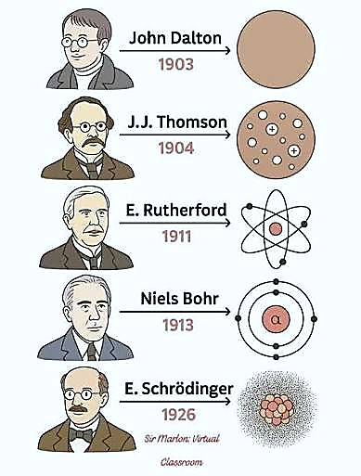
Basic Atomic Theory (History):
Democritus (400 BC): Atoms are indivisible
Dalton (1803): Atoms combine in fixed ratios
Thomson (1897): Electron discovered
Rutherford (1911): discovery of the nucleus
Bohr (1913): Electrons move in orbits
Schrödinger & Heisenberg (1926): Electron cloud, quantum model

Slide 3
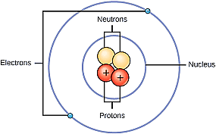
Basic Atomic Theory (Introduction):
Atomic theory explains structure of matter.
Matter is made of atoms.
Atoms are very small particles.
Atoms form all elements.

Slide 4
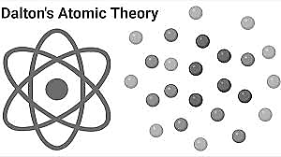
Dalton’s Atomic Theory:
Proposed by John Dalton.
Atoms are indivisible.
Atoms of same element are identical.
Chemical reactions rearrange atoms.

Slide 5
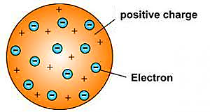
Thomson’s Atomic Model:
Electron was discovered by J.J. Thomson.
Atom is positively charged sphere.
Electrons are embedded in it.
Called plum pudding model.

Slide 6
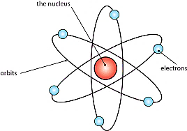
Rutherford’s Atomic Model:
Gold foil experiment was performed.
Atom has dense nucleus.
Most of atom is empty space.
Electrons move around nucleus.

Slide 7
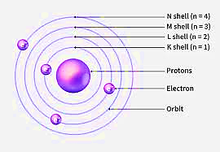
Bohr’s Atomic Model:
Electrons move in fixed orbits.
Each orbit has fixed energy.
Energy is absorbed or emitted.
Explains hydrogen spectrum.

Slide 8

Atomic Theory (Mathematical Form):
Electrons have quantized energy $E_{n}=−\frac{13.6 \text{eV}}{n^{2}}$
Where:
Eₙ = Energy of electron at nth orbit
n = Principal quantum number (1, 2, 3…)
−13.6 eV = Energy of electron in ground state (n = 1)

Slide 9
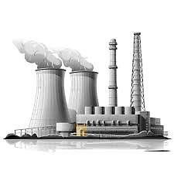
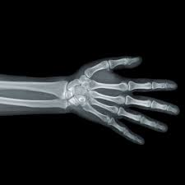

Applications of Atomic Theories:
Used in nuclear energy.
Used in medical X-rays.
Explains chemical bonding.
Used in electronics.

Slide 10
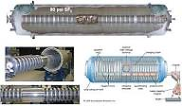
Particle Physics (History):
1897: Electron discovered.
1932: Neutron discovered.
20th century: Many particles identified.

Slide 11

Particle Physics (Introduction):
Particle physics studies smallest particles.
Explains forces of nature.
Uses high energy experiments.
Helps understand universe.

Slide 12
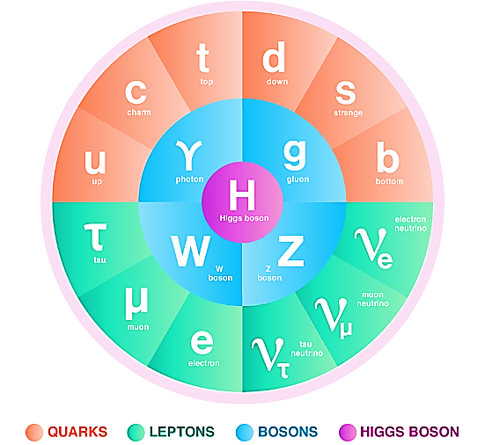
Fundamental Particles:
Leptons are light particles.
Quarks form protons and neutrons.
Bosons carry forces.
Particles build matter.

Slide 13


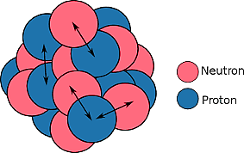
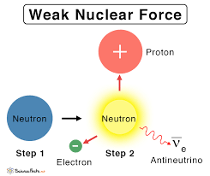
Fundamental Forces:
Gravitational force
Electromagnetic force
Strong nuclear force
Weak nuclear force

Slide 14
Particle Physics (Mathematical Form):
Mass and energy are related E = mc²
Where:
E = Energy
m = Mass
c = Speed of light in vacuum (c = 3 × 10⁸ m/s)

Slide 15
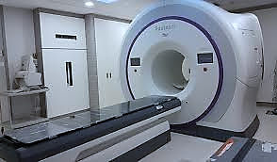


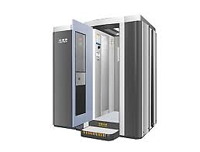
Applications of Particle Physics:
Used in cancer treatment.
Used in nuclear power plants.
Used in space research.
Used in security scanners.

Slide 16
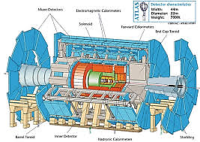
Standard Model (History):
Glashow (1960): Proposed unification of electromagnetic and weak forces.
Weinberg & Salam (1967): Developed electroweak theory.
Quantum Chromodynamics (1970s): Formulated strong force theory.
W and Z bosons (1983): Discovered, confirming electroweak theory.
Higgs boson (2012): Discovered at CERN, confirming Standard Model.

Slide 17
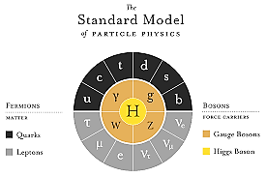
Standard Model (Introduction):
Standard Model explains particles.
Explains three fundamental forces.
Based on quantum theory.
Widely accepted model.

Slide 18
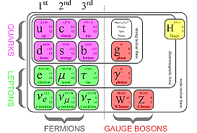
Components of Standard Model:
Quarks
Leptons
Gauge bosons
Higgs boson

Slide 19
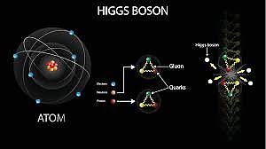
Higgs Boson:
Gives mass to particles.
Predicted by Standard Model.
Discovered in 2012.
Important discovery.

Slide 20
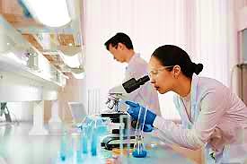
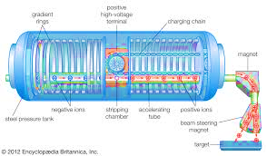
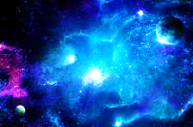
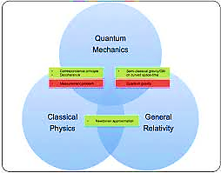
Applications of Standard Model:
Used in particle research.
Used in nuclear physics.
Helps understand universe.
Basis of modern physics.

Slide 21




Limitations of Standard Model:
Does not include gravity.
Cannot explain dark matter.
Cannot explain dark energy.
Needs improvement.

Slide 22
Conclusion:
Atomic theories explain matter.
Particle physics explains particles.
Standard Model unifies forces.
Physics research is ongoing.

